Slide 1


STAYING ON SIDE
How to Stop Match-Fixing
Emilija Taseva
Transparency International Secretariat
Final Conference Lisbon, 15 May 2014
This project has been funded with support from the European Commission - Directorate General Education and Culture.

Slide 2

Staying on Side anti-corruption and sports organisations working together to prevent match-fixing by helping protect the values of fair play, integrity and good sportsmanship in football.

Slide 3
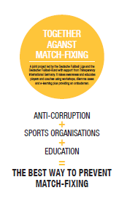
To raise awareness among key stakeholders and the general public
To pilot existing and develop new approaches and good practices in preventing match-fixing
To develop and test materials, tools and models for country- specific workshops
To train players, coaches, referees, technical staff of leagues, clubs, youth academies on how to avoid being part of match-fixing.

Slide 4
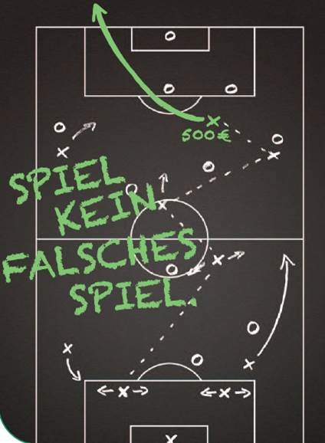
Part of wider European initiative for creating prevention programmes against match-fixing, involving other sport stakeholders FIFPro/UEFA, EU Athletes, Sportaccord.
Based on experiences of DFL project supported by TI Germany:
Trainings of young players by use of dilemma cases.
Code of Conduct
Ombudsman

Slide 5
KEY PROJECT ACTIVITIES
Kick off meeting (March 2013, Berlin). Communication and media training on match-fixing (September 2013, Berlin).
Evaluation Workshop (April 2014, Rome).
Project activities in Germany, Greece, Italy, Lithuania, UK, Portugal.
Leagues from Norway, Poland, Russia and ‘Play Fair Code’ Austria participated in project events.

Slide 6
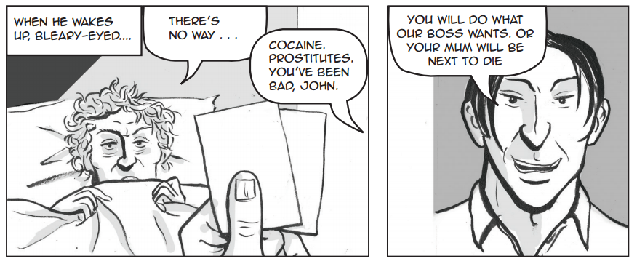

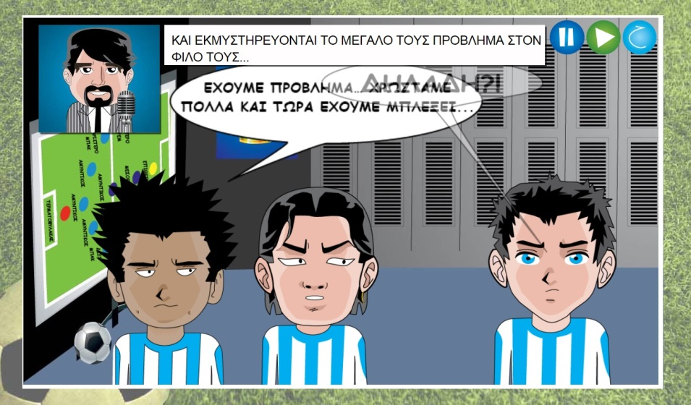
Training materials and tools

Slide 7
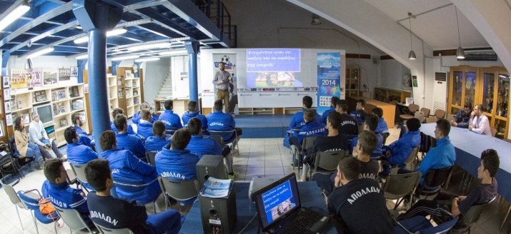
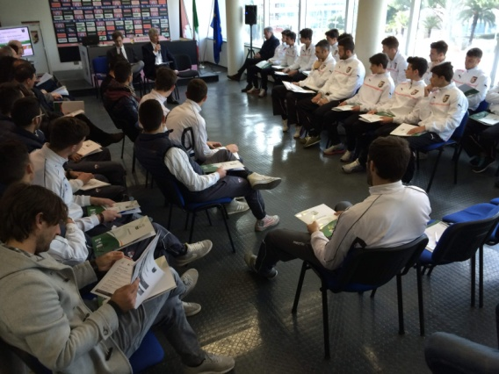
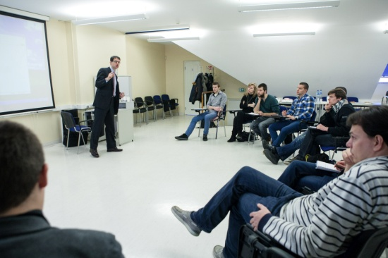
EDUCATION AND AWARENESS RAISING
Trainings for young football and basketball players
Risks of match-fixing
Gambling and gambling addiction
How to respond (codes of conduct, reporting/whistle-blowing systems)
Workshops, public debates with coaches, heads of youth academies, sport officials, academia, journalists.
More than 40 events, 400 participants, 80 multipliers.

Slide 8

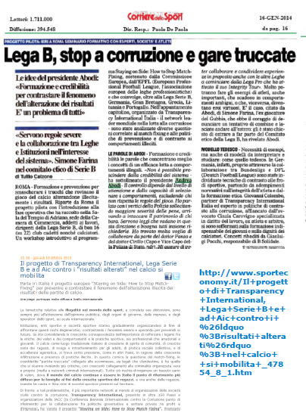

MEDIA OUTREACH
More than 100 related articles reproduced in newspapers or online media
Project websites
Press conferences

Slide 9


Research, surveys (Lithuania, Portugal, Italy)
International and national conferences, debates, interviews
Outreach to other stakeholders (FIFPro, EU Athletes, UEFA, Supporters Direct, government agencies for sport, referees)

Slide 10
LESSONS LEARNED
Education is the key to prevention. Educational programmes should be regularly repeated or made binding.
Importance of reliable whistleblowing system where players can report match-fixing and seek advice when facing a situation of match-fixing.

Slide 11
etaseva@transprarency.org
http://www.transparency.org/
Thank You!

